Slide 1
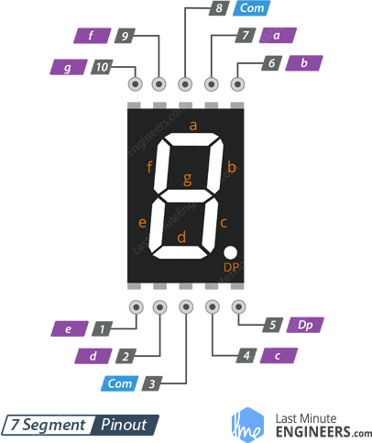

Decodificador BCD a 7 segmentos, Segmento $b$
Ing. Mario López

Slide 2
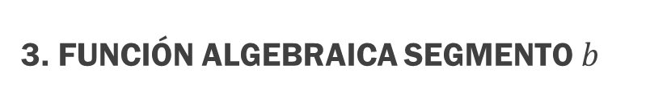
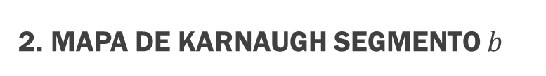

2. Mapa de Karnaugh segmento $b$
1. Tabla de verdad segmento $b$
Dec | A | B | C | D | b
0 | 0 | 0 | 0 | 0 | 1
1 | 0 | 0 | 0 | 1 | 1
2 | 0 | 0 | 1 | 0 | 1
3 | 0 | 0 | 1 | 1 | 1
4 | 0 | 1 | 0 | 0 | 1
5 | 0 | 1 | 0 | 1 | 0
6 | 0 | 1 | 1 | 0 | 0
7 | 0 | 1 | 1 | 1 | 1
8 | 1 | 0 | 0 | 0 | 1
9 | 1 | 0 | 0 | 1 | 1
 | 1 | 0 | 1 | 0 | X
 | 1 | 0 | 1 | 1 | X
 | 1 | 1 | 0 | 0 | X
 | 1 | 1 | 0 | 1 | X
 | 1 | 1 | 1 | 0 | X
 | 1 | 1 | 1 | 1 | X
AB CD | 00 | 01 | 11 | 10
00 | 1 | 1 | 1 | 1
01 | 1 | 0 | 1 | 0
11 | X | X | X | X
10 | 1 | 1 | X | X
3. Función algebraica segmento $b$
$$b=B^{′}+C^{′}D^{′}+CD$$

Slide 3











4. cIRCUITO para el segmento $b$
$$b=B^{′}+C^{′}D^{′}+CD$$
$$A$$
$$B$$
$$C$$
$$D$$
B$′$
$$C′$$
$$D′$$
$$B^{′}+C^{′}D′$$
$$C^{′}D′$$
$$b$$
Ánodo
$$CD$$
Cátodo

Slide 4
Muchas Gracias
Ing. Mario López

